Slide 1
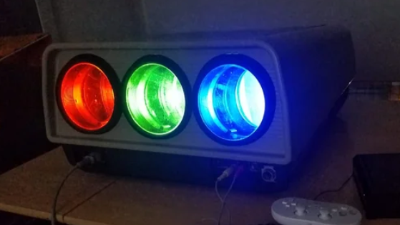
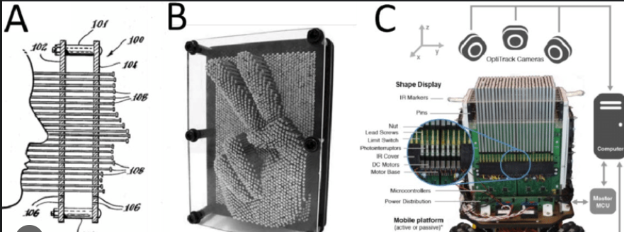
Re-imagining the pixel
Imagine we haven’t found CRT / Polarisation
We have coloured lightbulbs and small scale mechanics
Pincushion + mechanical driver
RGB CRT Projector
(but imagine we just use the lightbulbs)

Slide 2
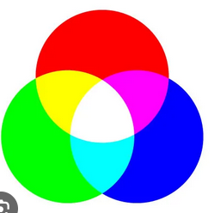

Controlling Variables
2 Problems to solve
Colour (3 dimensional)
Brightness (1 dimensional)
2 Variables
Rotation (2 axes in 3D space)
Distance (1 axis)
Seems clear we could use rotation for colour, distance for brightness
+

Slide 3
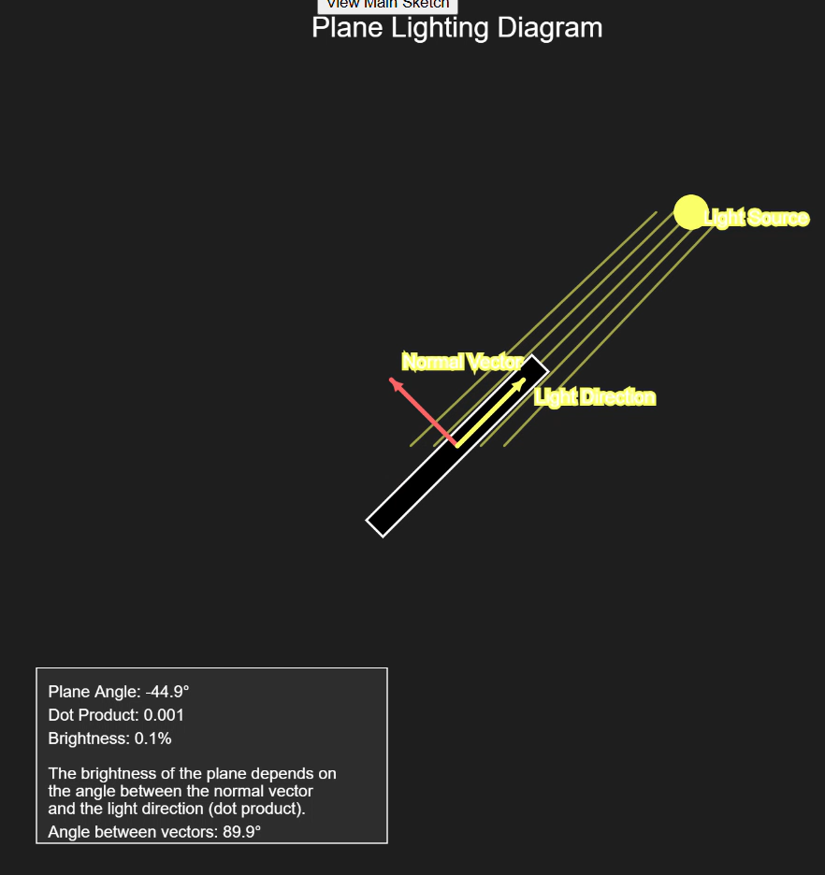
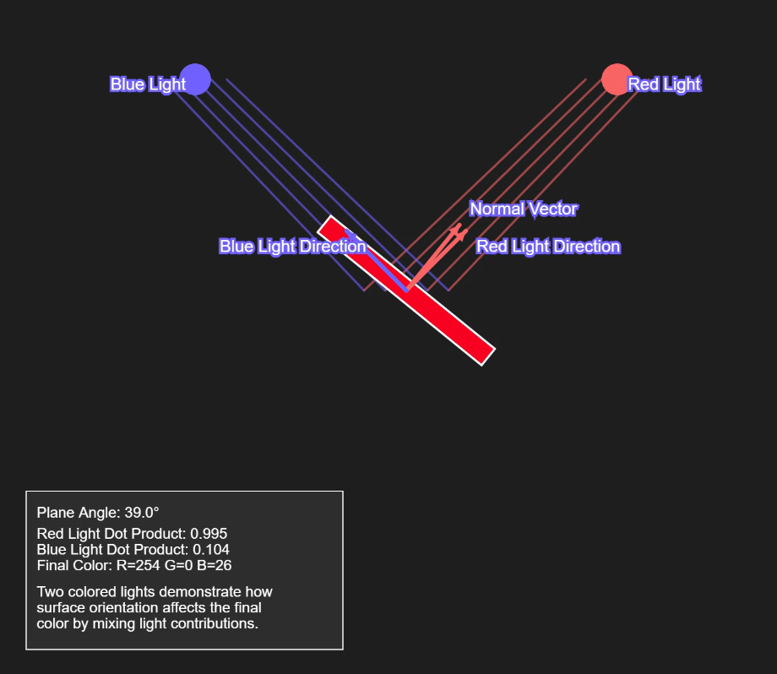
Colour / Rotation
The more aligned a plane is to a lightsource, the more the plane is coloured by the lightsource

Slide 4
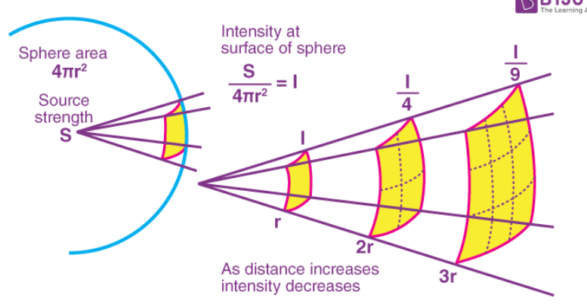
Brightness / Distance
The further the plane is from a lightsource the darker it becomes

Slide 5
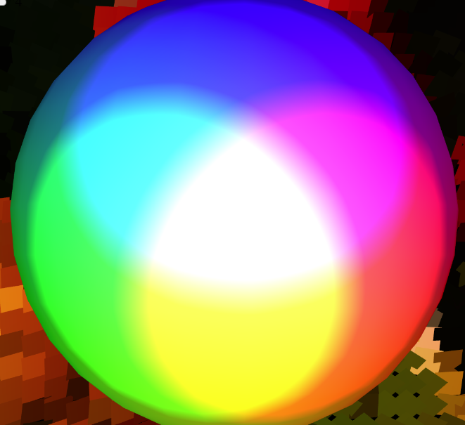
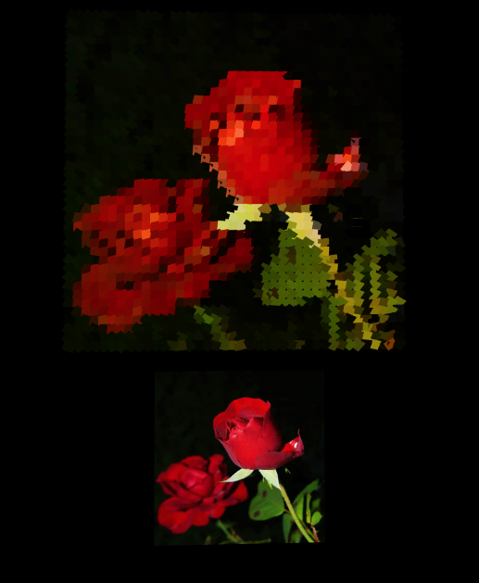
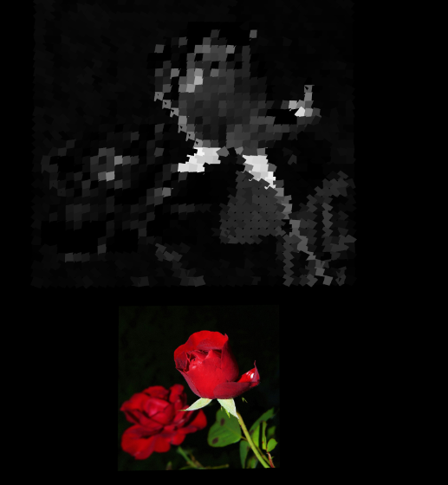
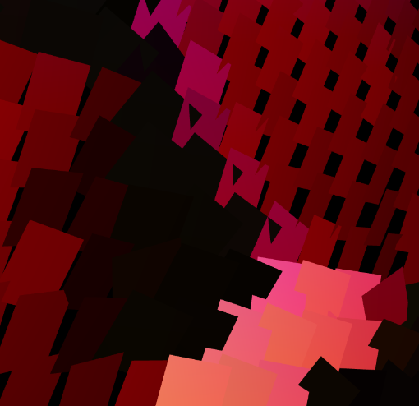
Draft – Colour only
RGB light sources on a sphere
Panels are “coloured” black/white
When lit by the rgb lights the image appears coloured
Black and white array
Grid of planes rotate to face lightsources
Reference image

Slide 6
Final – Brightness By Depth
RGB light sources on a sphere
Panels are “coloured” black/white
When lit by the rgb lights the image appears coloured
Black and white array
Grid of planes rotate to face lightsources
Reference image

